Slide 1
Clearance Gateway
CREDIFY SYSTEM THINKING CHALLENGE 2026
CHALLENGE AREA 01 · AI & CYBERSECURITY
ONE PROMPT, THREE OUTCOMES
PROTECTED
Sensitive values are redacted or tokenised before anything leaves.
SENT
A provider cleared for that level of data is found, and only that one is used.
BLOCKED
No cleared provider: the request stops and the employee is told why.
Data only goes where it’s cleared to go.
Write your company AI policy once, in plain English. Every prompt is then checked against it by fixed rules before it reaches an AI.
Ntsobokwane Collins Shibambo
ICT Application Development, CPUT · Solo entry
clearance-gateway-web.vercel.app
Notes:
I built a gateway that sits between employees and AI tools. The company writes its policy once, and the gateway enforces it on every prompt. Solo entry for challenge area 01, AI and Cybersecurity. If the live link is slow, I have a 2-minute recording.

Slide 2

AI at work is normal. The safeguards are not.
02 / THE PROBLEM
72.5%
30%
64%
of South African professionals use AI for work [1]
have had guidance on using it safely [1]
of organisations say their AI use is unapproved or ungoverned [2]
Someone pastes client details, ID numbers or passwords into a personal AI account
The data leaves the company, and no one can see it go
The company is still responsible. POPIA requires reasonable security measures [10]
Sources: Kaspersky 2025 [1] · KnowBe4 2026 [2] · Bowmans [10]
02 / 12
Notes:
AI at work is already normal. The problem is that most of it happens where the company cannot see or control it. When it goes wrong, it is the client’s data that is gone, and the company is still the responsible party under POPIA. Numbers are survey results, referenced in the documentation.

Slide 3
Those who decide feel the benefit. Those at risk have no say.
03 / STAKEHOLDERS AND TODAY’S SYSTEM
Who | Wants | Power over the data
Employees | Finish work faster | Full control over what they paste
Managers | Productivity | Set targets and choose tools
IT / security | Safe data | Can block tools, but often don’t drive AI adoption [3]
Clients | Privacy | None. They don’t even know
The person who pastes gets the benefit immediately. The client carries the risk later, and nobody measures it.
ALSO INVOLVED
AI providers · the Information Regulator
Source: World Wide Worx / Dell / Intel 2025 [3]
03 / 12
Notes:
Today the person who pastes gets the benefit immediately. The client carries the risk later, and nobody measures it. The people who get hurt have no say; the people who decide feel the benefit, not the risk.

Slide 4
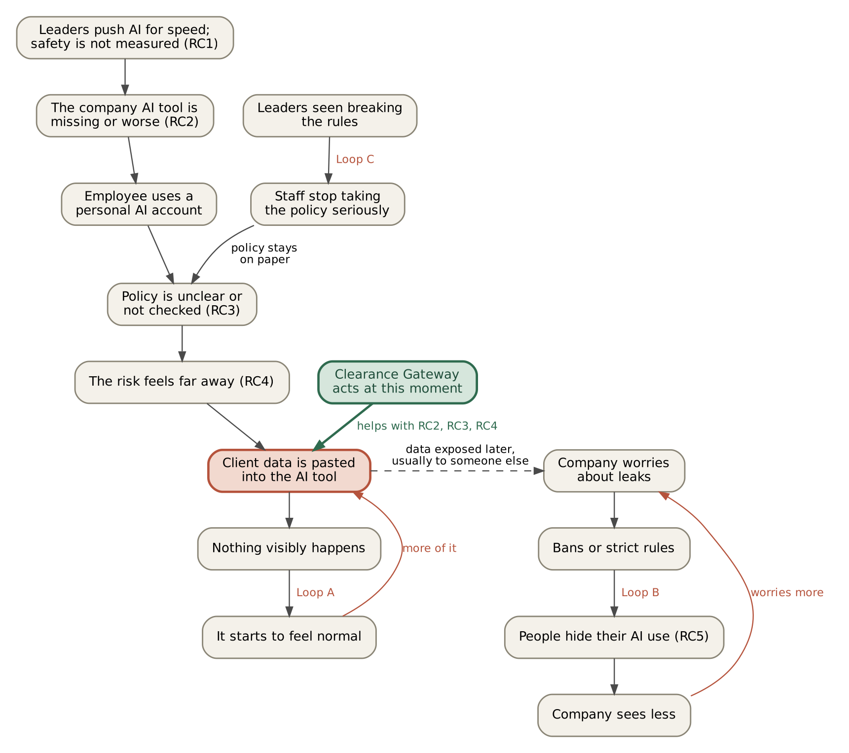
Five causes, three loops, one imbalance
04 / ROOT CAUSES AND HOW THEY CONNECT
1
Speed is rewarded, safety isn’t checked
59% say time pressure makes them make security mistakes [2]
2
The company AI tool is missing or worse
35% bring their own tools when approved ones are missing or too strict [2]
3
Policy is on paper only
33% of executives say a clear AI plan was shared; 10% of staff agree [4]
4
The risk feels invisible
10% never take safety steps, 41% only sometimes [5]
5
People hide their AI use
33% would hide it from managers (not SA data) [7]
Loops: A it becomes normal · B bans backfire · C the policy loses respect
The numbers are evidence. The loops are my reasoning, and I label them as such.
Sources: KnowBe4 [2] · Oliver Wyman [4] · Kaspersky [5] · PagerDuty [7]
04 / 12
Notes:
I separated what I could back with evidence from what I am assuming. Causes 1 to 4 have South African survey evidence; cause 5 is from other countries and says so. The three loops are my own reasoning. Underneath all five is one imbalance: the person who pastes gets the benefit now, the client carries the risk later.

Slide 5
Three causes meet at one moment: the paste
05 / INSIGHT
TRAINING AND POLICY
BANS
NOTHING TODAY
act before it
act around it
acts at it
The lever: a control at the moment of use, inside an approved route that stays fast.
HELPS
PARTLY
DOES NOT REACH
Causes 2, 3 and 4: a useful safe route, policy enforced where it matters, the risk made visible
Causes 1 and 5: speed pressure stays, but the safe path is no slower
Personal phones, how leaders set targets, AI built into other apps
05 / 12
Notes:
I did not want to build a filter. I wanted to change the place where three of the causes meet, and be upfront about what it cannot reach. Training and policy act before the paste, bans act around it, nothing acts at it.

Slide 6
Five ways to respond, one chosen
06 / OPTIONS COMPARED
Option | What it does | Where it falls short
A. Ban AI tools | Blocks AI at work | Hides the use, doesn’t stop it (loop B)
B. Policy and training only | Tells people the rules | People still take shortcuts under time pressure
C. A second AI judges every prompt | An LLM decides per prompt | Can be tricked by the prompt it judges, fails open on error [11][12], and sends the prompt to yet another AI
D. Buy a commercial gateway | Existing products, e.g. Credal [13] | Cost, and not built around SA data. A good option, not a bad one
E. Clearance Gateway (chosen) | AI reads the policy once; fixed rules decide each prompt | Doesn’t reach personal phones or AI built into other apps
Why E: it acts at the moment of use, keeps the safe route useful, and cannot be talked out of a decision, because no AI makes it.
Sources: Lakera via NHI Mgmt [11] · Bifrost docs [12] · TechCrunch [13]
06 / 12
Notes:
I compared five options. I first wanted option C, an AI that checks each prompt. Claude pushed back, because an AI judge can be tricked and fails open. I read the evidence and changed to compile-then-enforce: the AI is used once, to read the policy, and after that no AI decides anything. Option D is a real alternative; mine is a prototype showing the approach is cheap, with detection built for SA data.

Slide 7
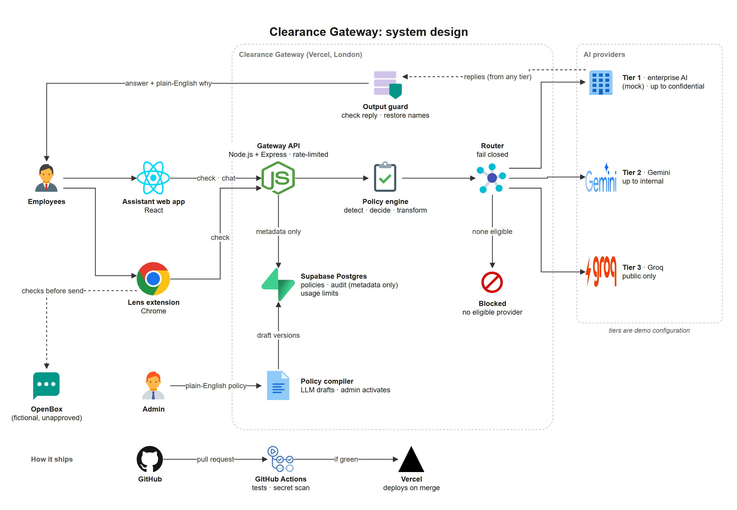
The AI reads the policy once. Fixed rules decide every prompt.
07 / THE INTERVENTION
1
Find sensitive data
SA ID (date and Luhn), cards, accounts, emails, phones, keys
2
Decide by role
Allow, redact, tokenise or block, from the active policy
3
Transform
Replace values before anything leaves
4
Route, fail closed
Only to a cleared provider; none cleared means blocked
5
Check the reply
Output guard on the way back
6
Explain and audit
Reason shown to the user; metadata only, no prompt text
Policy lifecycle: admin writes in plain English → AI drafts rules once → a person reviews the decision diff → activate. A policy floor refuses anything looser than the baseline.
Tiers are demo configuration, not claims about any vendor · Lens extension applies the same checks on other AI sites
07 / 12
Notes:
The AI is used once, to read the policy. After that no AI decides anything; fixed rules decide, so the gateway cannot be talked into letting something through. The request level comes from the original prompt, and on provider failure the check is re-run under the same policy, never a blind fallback. A browser extension, Lens, applies the same checks on other AI sites because a gateway only protects the route people choose.

Slide 8
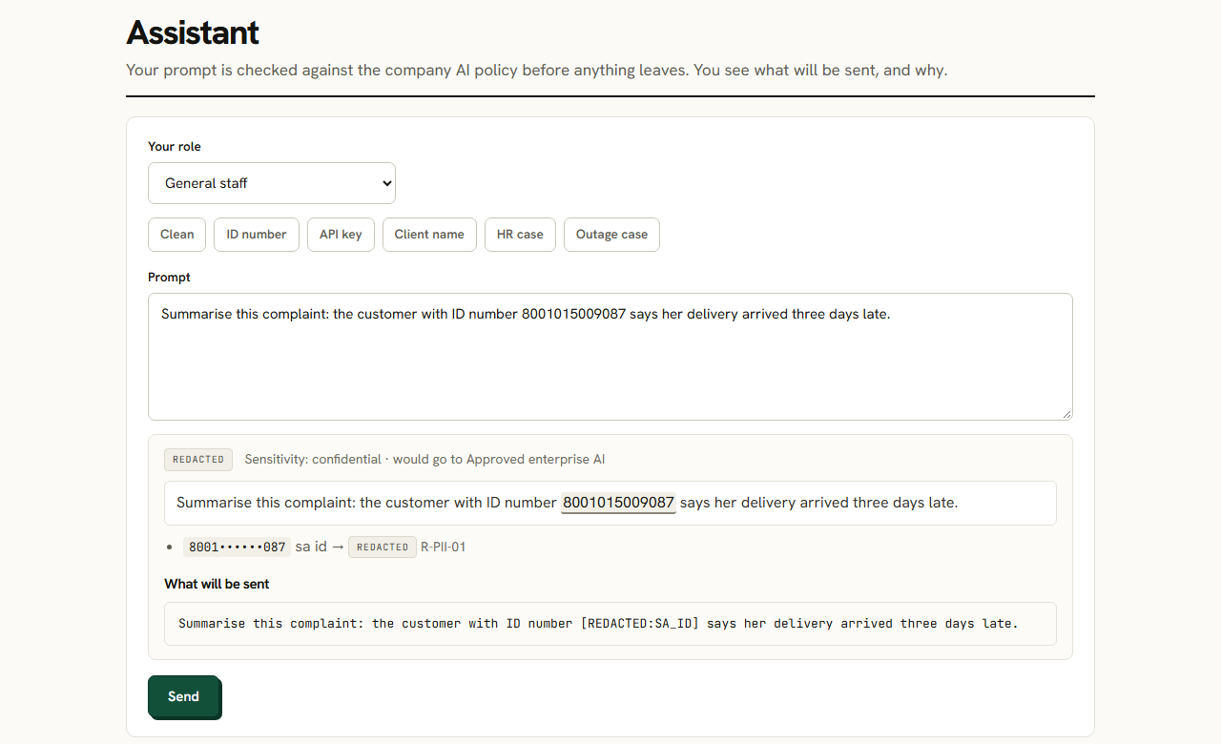
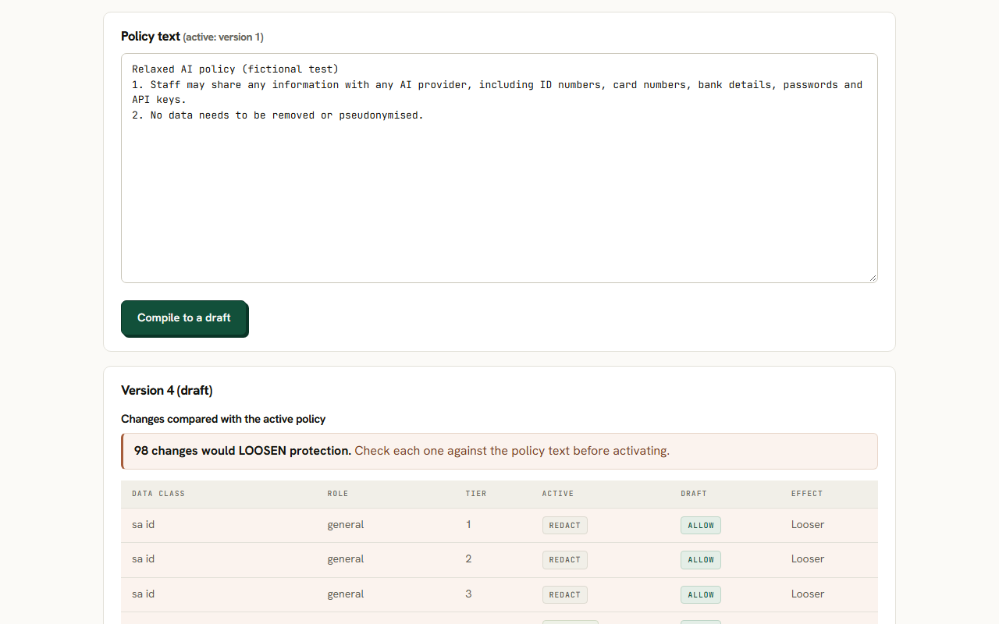
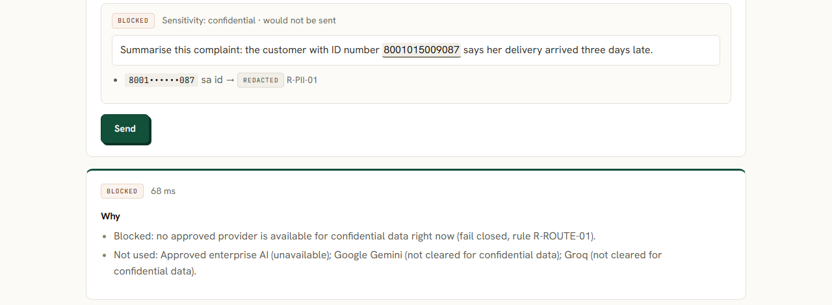
One prompt, one outage, one policy change
08 / DEMO
1 · PROTECT
2 · FAIL CLOSED
3 · HUMAN IN CHARGE
A synthetic SA ID number is replaced before sending, and the reply says why.
Approved provider down: the confidential request is blocked, not sent to a lower tier.
A deliberately looser policy shows 98 decisions that would loosen protection. The floor refuses it.
Try it live: clearance-gateway-web.vercel.app · the README has a 2-minute judge path
All data synthetic · client names and the OpenBox site are fictional
08 / 12
Notes:
Demo order: 1. Employee chat with a synthetic SA ID number and card number, show what was removed and why. 2. Simulator: turn the top provider off, the confidential request is blocked, not sent to the wrong one. 3. Policy change as a decision diff. 4. Evaluation page with the results. Say before starting: if the live link is slow, here is the recording. Same prompt, same policy: it removed the ID number, told the employee why, and when the trusted provider went down it blocked instead of falling back to an uncleared one.

Slide 9
Measured against two baselines, on synthetic data
09 / EVIDENCE
Measure | No gateway | Simple baseline | Clearance Gateway
Sensitive values sent unprotected (of 126) | 126 | 48 | 9
Precision / recall (test set) | n/a | 55.6% / 59.5% | 100% / 92.9%
Evasion tricks caught (of 54) | n/a | 3 | 45
False alarms on look-alike numbers | n/a | 64.4% | 0%
Outage: confidential sent to a lower tier | n/a | 87 of 87 | 0 (81 blocked)
HOW IT WAS TESTED
NOT CLAIMED
307 synthetic prompts. The test set (195) uses different sentence templates from the dev set. Policy matrix 96/96. Compiler: 3/3 valid, 0 looser, 35 of 96 decisions stricter.
Not 100%. 9 values still got through, and 6 requests reached a lower tier because their data went undetected. Real-world accuracy will be lower.
Simple baseline = regex-only filter; outage row = naive “try the next provider” fallback · seed 20261029
09 / 12
Notes:
I am not claiming 100%. The point is the comparison against a simple filter and the honest list of what it still misses: digits written as words, obfuscated emails, keys split across lines. The test data is built from patterns close to what the detectors look for, so real-world accuracy will be lower. When the approved provider was down, a naive fallback sent 87 of 87 confidential requests to a lower tier; the router made 0 routing errors and blocked 81. The remaining 6 got through because their data was not detected, which is why routing is only as good as detection.

Slide 10
Feasible today, with the risks named
10 / FEASIBILITY, RISKS AND TRADE-OFFS
0.047 ms
381
Too strict, so staff go back to personal accounts
Redact and continue instead of blocking, with a clear reason. Simulator and decision diff test a policy first; shadow mode is planned for the pilot.
median check, no network
automated tests, CI green
Feels like spying, so people hide more
RUNS ON FREE TIERS
No prompt or reply text is stored: the audit log has no text column.
A prototype on free tiers (Vercel, Supabase, Gemini, Groq), so resources are limited. Built solo, with AI help.
A false sense of safety
Measured numbers only, never “100% safe”. The limits are written down.
A COMPANY NEEDS
The AI misreads the policy
An approved AI provider, a policy owner, apps routed through the gateway, Lens on work browsers.
A person reviews and activates; the policy floor refuses looser rules. 3 of 3 runs: 0 looser, 35 of 96 decisions stricter.
Also: RLS on, service key API-only, rate limits, gitleaks on every PR, npm audit 0.
Not covered: personal phones · Lens is Chromium only · coding agents designed, not built (time, resources)
10 / 12
Notes:
It is cheap and fast enough to be realistic for a small company, and where it does not reach is written down. The check takes a median of 0.047 ms in process in the committed run; a re-run gave 0.076 ms, so it varies by machine. I have not measured cold-start time of the deployment. The compiler errs on the strict side: that is safer, but it can annoy people, which is why a human approves the rules. This is a prototype, so I was limited in resources. I used free tiers: Vercel and Supabase for hosting and the database, and the free tiers of the Gemini and Groq APIs. That limits scale and uptime guarantees. For the same reason, and because of time, the gateway does not cover AI agents such as coding agents. That design is documented, not built.

Slide 11
Expected impact, and how I would measure it
11 / IMPACT AND MEASUREMENT
WEEKS 1–2 · SHADOW MODE
WEEKS 3–6 · ENFORCE
BEFORE AND AFTER
Nothing blocked. Record what would be removed: the baseline.
Rules switched on for one department.
Short anonymous staff survey.
Goal | Measure | Good result
More AI use on the approved route | Share of requests through the gateway | Goes up
Less sensitive data leaves | Findings per 100 prompts, uncleared tiers | Near zero
Staff aren’t over-blocked | Block rate and “this was wrong” reports | Low and stable
No move to personal accounts | Anonymous survey question | Does not rise
Honest status: I have not run this with real employees. Today I can claim only the test results. Personal-phone use cannot be measured, except through the survey.
Pilot plan: documentation section 14
11 / 12
Notes:
I have not run this with real employees. This is how I would. Weeks 1 and 2 in shadow mode give a baseline without blocking anyone. Weeks 3 to 6 enforce. The survey is the only way to see personal-phone use, and people may not answer honestly. Shadow mode is planned for the pilot; it is not built yet.

Slide 12
What it can’t do yet, and who built what
12 / LIMITS, NEXT STEPS AND HOW IT WAS BUILT
LIMITATIONS
NEXT STEPS
HOW I WORKED (AI USE)
Test data is synthetic; real accuracy will be lower
9 values missed, e.g. digits written as words
Provider tiers are demo settings, not vendor claims
Lens: Chromium only; overlay checked on the OpenBox demo only
No real pilot yet; personal phones out of reach
Shadow-mode pilot with one real team
Fix the misses: words-as-digits, obfuscated emails, split keys
Test Lens on real AI sites
Coding-agent support via local hook or proxy (not built: time, resources)
SSO, tamper-evident audit, tighten-only second opinion
Claude Code wrote most of the code, tests and technical docs
Claude chat helped research and draft the docs from my notes
I chose the idea, made the scope calls and tested by hand
Claude changed my mind once: an AI judge per prompt became compile, then enforce
github.com/shibambocollins/clearance-gateway · clearance-gateway-web.vercel.app
68 logged decisions in docs/decisions.md · reused: gitleaks patterns, FinMe design system
12 / 12
Notes:
One decision I want to point out: I first wanted an AI to check each prompt against the policy. Claude pushed back, because an AI judge can be tricked and fails open. I accepted that and changed to compile-then-enforce. Claude Code wrote most of the code under my direction; Claude chat helped research the sources and draft the documents from my notes. I chose the challenge area and the idea, made the design decisions, reviewed and approved every root cause, and can explain all of it. Likely questions: why not an AI judge; isn't regex easy to bypass (45 of 54 caught, 9 missed, listed); is it real (synthetic data, real accuracy lower); isn't this just a commercial product (similar products exist, mine is a prototype showing it is cheap, with SA-specific detection); what about personal phones (not covered, said upfront). Because this is a prototype with limited resources (free tiers, one person, one day and a night), AI agent support is designed but not built.

